Slide 1
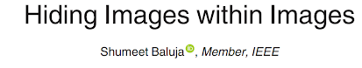
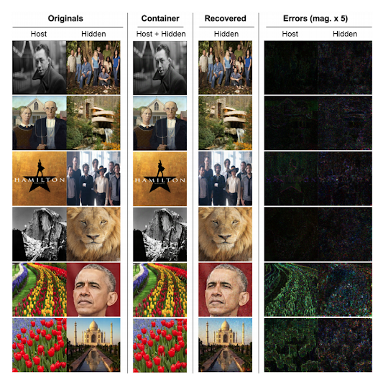
Problem:
Embedding a full-color image within another full-color image of the same size without perceptible errors
Why:
Authorship & copyright info
Detect altered images
Meta-information
Motion vectors
Bounding boxes
Extended-color and depth info
Send a secret message without a secure channel

Slide 2
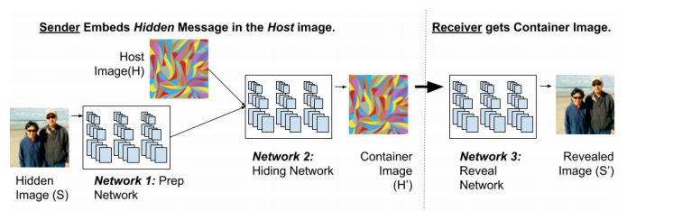
Method
Prep Network extracts the features to be hidden by the Hiding network.
Hiding Network decides how the Host image should be manipulated so that the container image is represented with as little disturbance as possible to the Host image while also protecting their recoverability.
Reveal Network tries to construct the Hidden Image with as little distortion as possible.

Slide 3
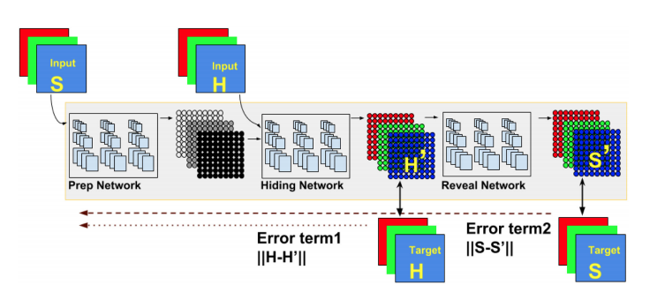
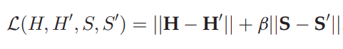
Method
Prep Network and Hiding Network are optimized with the loss function , which is basically the L2 norms of ||Original Image – Container Image|| + ß × ||Hidden Image – Recovered Image|| .
Reveal Network is only optimized by ||ß * Hidden Image – Recovered Image || as it does not need to reconstruct the host image.

Slide 4
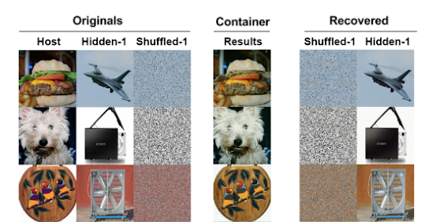
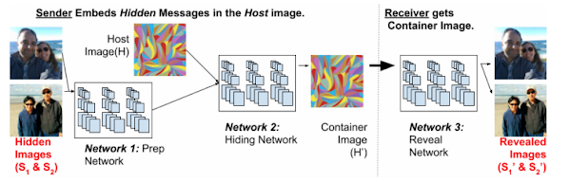
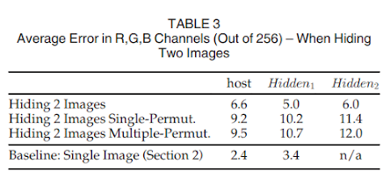
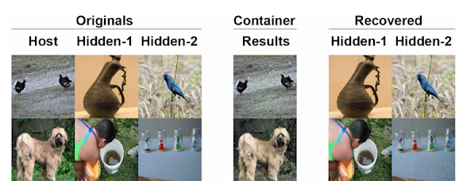
Improvements
Obfuscating the Existence of a Hidden Image:
Hidden Image is shuffled before being passed to Hiding network.
The reveal network reveals the shuffled version of the hidden image.
The revealed image is unshuffled to recover the actual hidden image.
Hiding two Full Sized Images:
Instead of one, even two images can be stored in the Host image with minimal extra distortion compared with hiding only one image.
This also makes it more resistant to steganalysis.

Slide 5
Disadvantages/limitations/downsides: | Possible improvements:
Existence of hidden information is detectable even when the original host image is not publicly available | A discriminator network feeding an error signal based on discoverability of the hidden image Encoding hidden information in the frequency domain instead of spatial domain Less capacity
Content of hidden information is detectable | Encoding hidden information in the frequency domain instead of spatial domain Less capacity Incorporating cryptographic schemes to obscure both spatial and color distribution
Computationally expensive to train | Design more efficient networks Buy some graphic cards

Slide 6
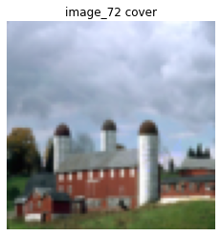
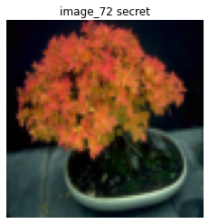
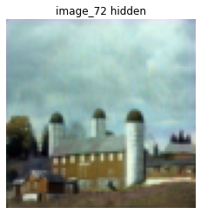
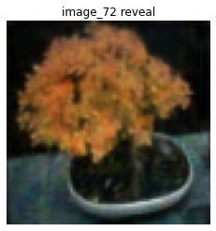
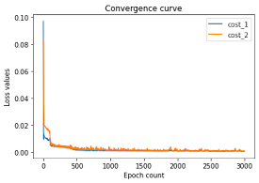
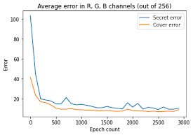
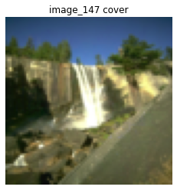
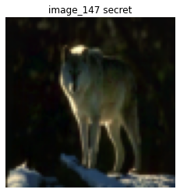
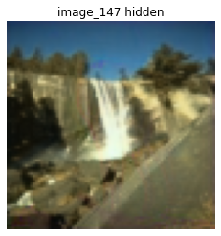
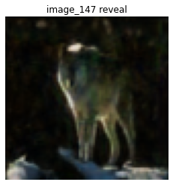
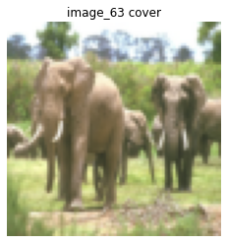
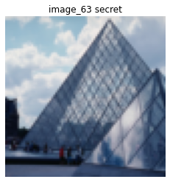
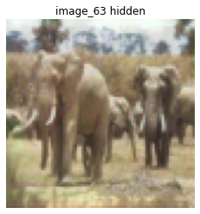
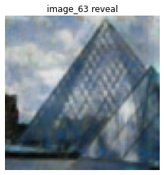
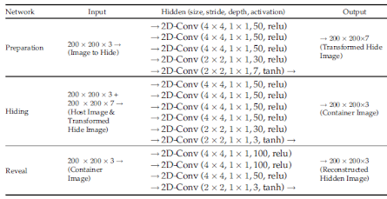
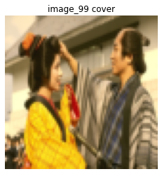
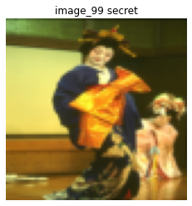
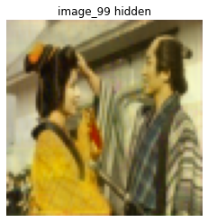
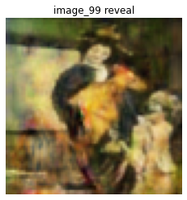
Implementing the model
Training cover error: 8.99
Training secret error: 10.42
Database: Berkeley Segmentation Dataset
Training/Test sets: 300/200 80x80 images
Preprocessing: Normalize by color channel
Optimizer: Adam
Test cover error: 9.23
Test secret error: 13.04

Slide 7
Proposed solution 1: Discriminator network
Hypothesis:
Simultaneously training a discriminator network and feeding its output proportionally to its accuracy as an error term to the preparation and hiding network would improve the undetectability of the existence of hidden information
Possible outcomes:
When subjected to steganalysis methods, probability of discovering of the existence of hidden information would be less than the original model
Since representation of the hidden information in nearby pixels increases detectability, discriminator network would probably urge the model to disperse the representation to pixels further away
We could test this by manipulating a group of pixels in the input image and track the resulting changes in the output

Slide 8
Proposed solution 1: Discriminator network
Input
Secret
Input
Container
Discriminator Network
Error Term 3
If Secret+Container detected as containing secret
Prep Network
Hiding Network
Output Secret + Container
Reveal
Network
Output Revealed
Error Term 1
(Secret+Container) - Container
Target
Container
Error Term 2
Secret - Revealed
Target
Secret
Could not implement due to limited computational resources

Slide 9
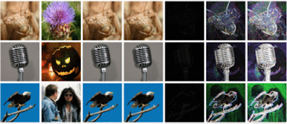
Proposed solution 2: Blur & subtract operation
Input
Secret
Input
Container
Blur & Subtract Operation
Error Term 3
How susceptible is Secret+Container
Prep Network
Hiding Network
Output Secret + Container
Reveal
Network
Output Revealed
Error Term 1
(Secret+Container) - Container
Target
Container
Error Term 2
Secret - Revealed
Target
Secret

Slide 10
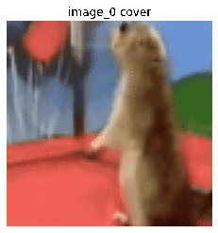
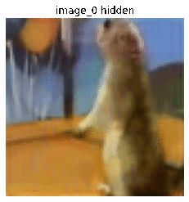
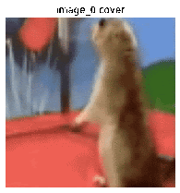
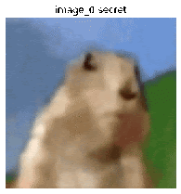
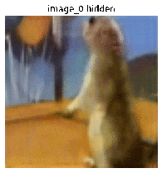
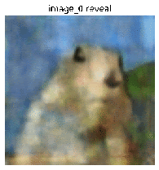
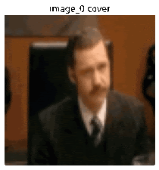
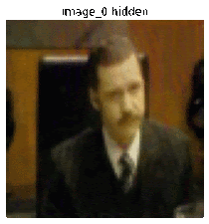

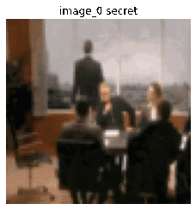
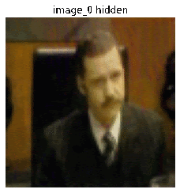
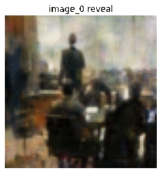
Extension to GIF/Video
Hypothesis: Using the same network, we can halve the size of a GIF/video and hide the second part within the first without distorting the images
Approach: Extract frames from a GIF, designate first half of the frames as host images and the other half as secret. The recipient with the reveal network decodes the hidden half to view the full GIF
Original GIF Resulting GIF Cover Secret Hidden (Cover + Secret) Reveal (Secret)
File size compression = 41.7%
File size compression = 42.7%

Slide 11
What we learned?
Tensorflow version 1 :)
Steganography
How to build deep neural networks
How to implement a model from an article
How to critically evaluate limitations/possible extensions of a system in an article
How to create GIFs
How to secretly communicate our evil agenda via the social media through GIFs that look like innocent memes

